Slide 1
Publishing Guidewire Web Services
May 1, 2014
Notes:
Guidewire training materials contain Guidewire proprietary information that is subject to confidentiality and non-disclosure agreements. You agree to use the information in this manual solely for the purpose of training to implement Guidewire software solutions. You also agree not to disclose the information in this manual to third parties or copy this manual without prior written consent from Guidewire. Guidewire training may be given only by Guidewire employees or certified Guidewire partners under the appropriate agreement with Guidewire.

Slide 2
  Publish a Guidewire web service
  Return instances of a Gosu class from a web service
  Test web services locally
  Describe how external systems connect to a Guidewire web service

Slide 3
Publishing Guidewire web services
Returning objects from web services
Testing web services
Consuming Guidewire web services

Slide 4

Guidewire web services
doesContactExist()
getContactInfo()
setContactEmail()
ContactAPI
External
system
A Guidewire web service is a web service hosted by the Guidewire application that external systems use
Guidewire web services are appropriate for integration points where:
  External requests are synchronous
  External requests use the SOAP protocol
Notes:
Every Guidewire application comes with a set of base application web services. By convention, web services have names that end in "API“. In some situations, the web service needed by an integration point may already exist.
For web services that manipulate system data, Guidewire recommends you use the web services provided in the base application. An example is MaintenanceToolsAPI. The MaintenanceToolsAPI WsiWebService can start a batch process remotely.
For web services that manipulate business data, Guidewire recommends that you create a custom web service, even if there is already a similar web service in the base application. Custom web services ensure that exactly the correct data is being exchanged. One of the greatest benefits of custom web services is the ability to control the amount of data transferred, which can yield significant performance improvements. For example, a getABContact() API might it return a large ABContact instance with multiple fields and complex data, but the given integration point needs only the public ID, the name, and the primary address.

Slide 5
Guidewire support for WS-I web services
WS-I
WSDL
XSD
WS-I is a common, industry standard
WS-I provides an XSD for a data validation
  XSD is a schema definition document
Guidewire 8 deprecates the publishing of RPCE web services
Notes:
For information on how to write a Guidewire web service using RPCE, refer to the Integration Guide. Guidewire 8 deprecates the publishing of RPCE web services.

Slide 6
Create a Guidewire WS-I web service
Create the package
Create the Gosu class
Add the web service annotations
Add methods
  Method that modify Guidewire data must create and commit a bundle
Deploy your changes
Notes:
Any method that modifies Guidewire data must create and commit a bundle.

Slide 7
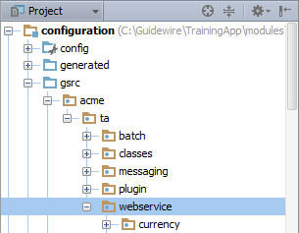
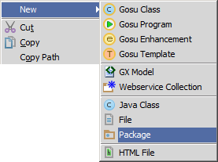
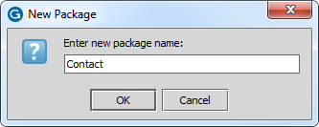
Step 1: Create a package
/configuration/gsrc/
  Create package
  New → Package
Guidewire naming convention recommendation
  <company>.<app_code>.webservice.<functional_area>
  Example: acme.ta.webservice.contact
Notes:
To create a package:
1. Right-click the package that is to be parent of new package.
2. Name the package. The name must be unique for the given parent.
The package roots "com.guidewire" and "gw" are reserved. You should not create any child packages in either of these packages.
For more information on recommended naming conventions for packages, refer to the "Gosu for Integration" lesson.

Slide 8
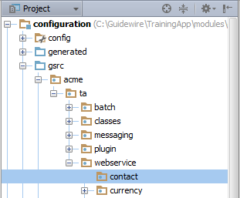
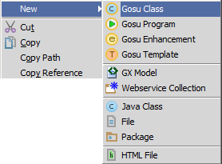
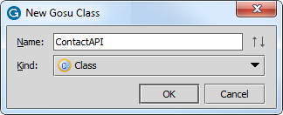
Step 2: Create Gosu class
Naming convention for web service class:
  <meaningfulName>API
Example: ContactAPI

Slide 9
Step 3: Add web service class annotations
6 uses gw.xml.ws.annotation.WsiWebService
7 uses gw.xml.ws.annotation.WsiPermissions
8 uses gw.xml.ws.annotation.WsiAvailability
9 uses gw.xml.ws.annotation.WsiGenInToolkit
10
11 @WsiWebService
12 @WsiPermissions({"abedit"})
13 @WsiAvailability(MAINTENANCE)
14 @WsiGenInToolkit
15
16 class ContactAPI {
Required
  @WsiWebService annotation is required for WS-I web service class
Optional
  @WsiPermissions specifies user permissions; default to soapadmin
  @WsiAvailability first usable run level; default is maintenacnce
Notes:
The @WsiPermissions annotation specifies the permissions a user needs to invoke a web service. Permissions are specified as an array of SystemPermissionType typekey values.
If the annotation is omitted, the permissions default to "soapadmin".
If no permissions are required, then the annotation should be specified but have an empty array: WsiPermissions({}). Multiple permissions can be specified within the array as in: @WsiPermissions({"abcreate", "abedit"}). The @WsiPermissions annotation can also be used for methods in the class. A method-level annotation always takes precedence over a class-level annotation.
The @WsiAvailability annotation specifies the minimum system run level when a web service becomes available. Valid values include:
MULTIUSER – Normal state just after start up. Product is live and users can login to UI.
SHUTDOWN – The app server is up, but the product is not available
DAEMONS – The product is running and background processes can run, but users cannot log in to the UI.
MAINTENANCE – This is the default value. (Also known as "NODAEMONS") The app server and product are running, but no background processes.
The term "background processes" can be misleading, because there should be only one JVM process involved in running a Guidewire server instance. These background processes are actually run by additional threads within the JVM process.

Slide 10
Step 4: Add methods
23 // Method that simply returns a value
24 function doesContactExist (publicId : String ) : boolean {
25 var queryObj = gw.api.database.Query.make(ABContact)
26 queryObj.compare("PublicID", Equals, publicId)
27 return (not queryObj.select().Empty)
28 }
Method can accept and/or return:
  Simple values: Booleans, numbers, strings, lists, arrays
  XML types
  Gosu objects (discussed later in this lesson)
Method cannot accept or return an instance of a
data model entity!
Notes:
For methods that calculate and return simple values, there is no difference between the syntax for a non-web service Gosu class and a web service Gosu class.
A doesAccountExist() method example specifies an argument for a publicId. The publicId argument represents a unique value that identifies a specific entity in the Guidewire database. From carrier to carrier, the value will most likely vary, but it is not unusual for it to be a tax ID, FEIN (Federal Employer Identification Number), or some similar type of value.
When writing a "does...Exist()" method, Guidewire recommends writing a Gosu query that queries for the object using a unique identifier and then reads the result object's Empty property. The Empty property returns true only if the query found no matching rows. This is the least resource-intensive approach to determine whether or not the number of results is 0.
A WS-I web service cannot return an instance of a Guidewire data model entity.

Slide 11
runWithNewBundle() for WS-I web service
30 function setContactEmail (publicId : String, email : String)
31 : void {
32 // query for contact with given public ID
33 var queryObj = gw.api.database.Query.make(ABContact)
34 queryObj.compare("PublicID", Equals, publicId)
35 var targetContact = queryObj.select().AtMostOneRow
36 // create new bundle
37 gw.transaction.Transaction.runWithNewBundle( \ newBundle -> {
38 // targetContact is in read-only. Add it to newBundle
39 targetContact = newBundle.add(targetContact)
40 // Modify contact
41 targetContact.EmailAddress1 = email
42 // runWithNewBundle implicitly commits bundle
43 })
44 }
For web service methods committing data, create a bundle
  gw.transaction.Transaction.runWithNewBundle()
Notes:
If data must be committed to the database, create a new bundle using the runWithNewBundle() method. Bundles created with runWithNewBundle() are writeable. The method takes a block argument.
In the example above, the first portion of the block simply names the new bundle object as newBundle. The second part of the block specifies the code execute, i.e., creating and editing data, within closure of the bundle. At the closure of the block, the application executes an implicit commit of the bundle data. Do not explicitly commit a bundle – e.g., bundle.commit() – in a runWithNewBundle() block.
Queries for data model objects always return a read-only bundle. Line 35 is a query that returns a single entity of the type ABContact that is read-only. To modify a read-only data model object, copy the object to a writeable bundle. Line 39 copies the queried object into the writeable bundle using the add() method.
For more information on bundles, refer to the Gosu Bundles lesson.

Slide 12

Step 5: Deploy your changes
WSDL for
ContactAPI, please
External
system
ContactAPI
ContactAPI?WSDL
Deploy happens when consumer requests WSDL
  Client requests WSDL
    http://<host>:<port>/<appcode>/ws/<package>/<class>?WSDL
Publisher
  Running Guidewire application server generates WSDL
  Not generated until consumer requests
Notes:
As long as the Gosu class is known to the server when the request comes in, the server can generate the WSDL. The WSDL itself is not generated until an external web service requests it.
Redeployment of the Gosu web service class on the server which contains web service method signature changes, newly added web service methods, and/or deleted web service methods, will require that you regenerate the WSDL for the web service consumer (client).

Slide 13
Publishing Guidewire web services
Returning objects from web services
Testing web services
Consuming Guidewire web services

Slide 14
Returned objects from web service
46 // Method that returns instance of a Gosu class
47 function getContactInfo (publicId : String) : ContactInfo {
48 var queryObj = gw.api.database.Query.make(ABContact)
49 queryObj.compare("PublicID", Equals, publicId)
50 var targetContact = queryObj.select().AtMostOneRow
51 var aContactInfo = new ContactInfo()
52 aContactInfo.contactName = targetContact.DisplayName
53 aContactInfo.contactType = targetContact.Subtype.DisplayName
54 aContactInfo.email = targetContact.EmailAddress1
55 aContactInfo.primaryPhone =
56 targetContact.PrimaryPhone.DisplayName
57 return aContactInfo
58 }
Method can return object
Returned object must be of a Gosu class type that is usable as a web services return type
Notes:
A common use case for returning an object from a web service is a summary or "info" object that contains selected fields from a much larger object. Complex data can also be returned as an XML structure.

Slide 15
Gosu class for web service return types
1 package acme.ta.webservice.contact
2 uses gw.xml.ws.annotation.WsiExportable
3
4 @WsiExportable
5
6 final class ContactInfo {
7 construct() {
8 }
9 // ContactInfo class properties
10 var _contactName : String as contactName
11 var _contactType : String as contactType
12 var _primaryPhone : String as primaryPhone
13 var _email : String as email
14 }
@WsiExportable ensures that object is XML serializable
final ensures class cannot be subtyped
Notes:
A Gosu class whose instances are used as return types for web services must include the @WsiExportable annotation and be marked as final.
The @WsiExportable annotation ensure that instances of the class can be easily serialized into XML.
A class that can be subtyped has the potential to introduce complexity into a web service architecture that is difficult to maintain. To ensure that Guidewire web services provide maximum flexibility with minimal maintenance, Gosu classes used as web service return types cannot be subtyped. For this reason, the class must be marked as final.

Slide 16
Publishing Guidewire web services
Returning objects from web services
Testing web services
Consuming Guidewire web services

Slide 17
Testing web services
Publisher
Consumer
external
system
Production
web service
WSDL
Gosu
test
code
Test
web service
local WSDL
Play both roles: publisher and consumer
Generate a local WSDL to test Guidewire published web services
Notes:
In a production environment, two systems are involved in the use of a Guidewire web service: the publisher and consumer.
In the instance where Guidewire is the publisher, Guidewire generates the WSDL for a web service with the consumer request. The external system is the consumer. The consumer stores a copy of the WSDL and uses that copy to make requests.
It is possible to test web services within a single instance of Guidewire by assuming the roles of both publisher and consumer for the web service. The only additional step involved is the creation a "local WSDL" that Gosu code can use for testing purposes.

Slide 18
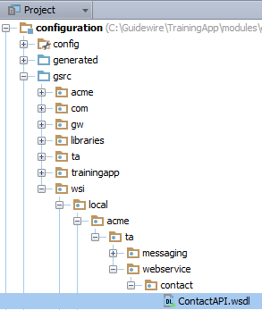
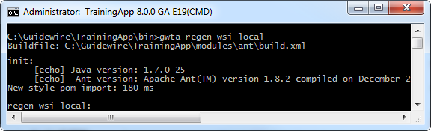
WSDL generator for local web services
gwXX regen-wsi-local
  Run from command line
Generates local WSDLs for all web services
  gsrc/wsi/local/
Restart the Guidewire application
Notes:
If you generate a local WSDL from the command line while Guidewire Studio is open, you will need to restart the Guidewire application in order for Gosu Scratchpad to execute the reference to the local wsi.
To restart the application while in Guidewire Studio, follow these steps:
If Studio is Running or Debugging the Server, Stop the server in Studio.
After the server stops, then Run or Debug the Server from Studio.

Slide 19
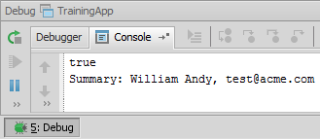
WSDL local test example
1 var localAPI = new wsi.local.acme.ta.webservice.contact
2 .contactapi.ContactAPI()
3 // authentication settings
4 localAPI.Config.Http.Authentication.Basic.Username = "su"
5 localAPI.Config.Http.Authentication.Basic.Password = "gw"
6 print(localAPI.doesContactExist("ab:5"))
7 localAPI.setContactEmail("ab:5","test@acme.com")
8 // create webservice return type
9 var info = localAPI.getContactInfo("ab:5")
10 print("Summary: "+ info.ContactName + ", " + info.Email)
Syntax to create an API instance from a local test WSDL
  var API = new wsi.local.package.class.Service()
Debug Server →
Gosu Scratchpad →
Run in Debug Process →
Verify Console output
Notes:
Use code completion to easily determine the class and service names.
When testing a Guidewire web service locally, it is not necessary to create a web service collection that points to the web service to be tested.

Slide 20
Publishing Guidewire web services
Returning objects from web services
Testing web services
Consuming Guidewire published web services

Slide 21
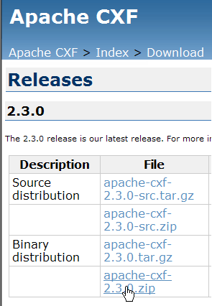
Consuming a Guidewire web service
For Guidewire web services called from Java:
  Guidewire creates the WSDL
  A third-party tool, such as Apache CXF or Axis, creates client code as needed from the WSDL
  The client code must then establish a connection and call the API
Details for these steps vary based on the tools chosen
  Next slides show an example
Notes:
The steps needed to get a third-party application to consume a Guidewire-published web service vary based on the nature of the third-party application. It isn't possible to exhaustively discuss the different scenarios an integration developer might encounter. The following slides attempt to provide an overview of the process by walking through one specific example. This is intended for use as an overview only. The high-level steps are applicable in most situations, but the specifics will vary.
The example in the following slides involves a third-party application written in Java that needs to consume a Guidewire web service called ContactAPI. The third-party application is coded using Eclipse. Apache CXF version 2.3.0 is used to create Java code for the third-party application from the WSDL.
Guidewire web services can also be called from .NET and from any external system that has binding implementations of WSDL and SOAP. For more information on non-Java consumption of Guidewire web services, refer to the Integration Guide.

Slide 22
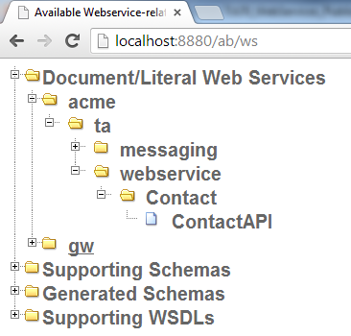
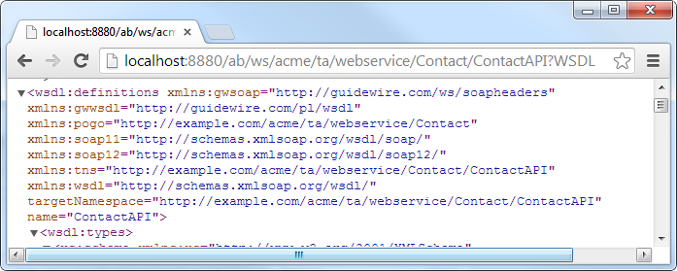
Step 1: Determine WSDL URL
Find available WSDL at:
  http://<machine>:<port>/
  <appcode>/ws
Notes:
First, the integration developer working with the third-party system must access the WSDL for the Guidewire web service. All WSDLs for Guidewire-published web services can be accessed following the instructions below.
To determine the URL for the WSDL:
While the application server is running, connect to http://<machine>:<port>/<appcode>/ws.
Expand the Document/Literal Web Services node until the desired web service name is displayed.
Click the web service name. This loads the XSD for the WSDL.
Copy the URL.
The information above applies only for WSDLs for document literal web services. For information on how to find WSDLs for deprecated RPCE web services, consult the Integration Guide.

Slide 23
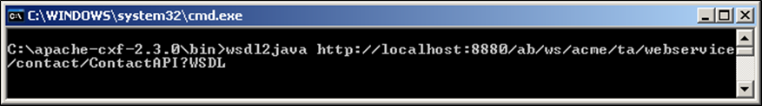
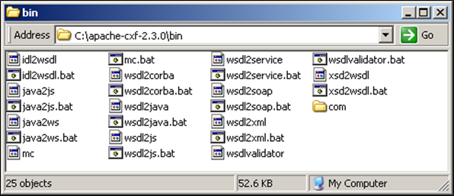
Step 2: Generate code the WSDL
Apache CXF
  Open bin directory in Command Window
  Run the wsdl2java ("wsdl to java")
  Specify the WSDL's URL
Creates a /com subdirectory containing the Java stubs
Notes:
In Apache CXF, from the bin directory, run the wsdl2java ("wsdl to java") command and specify the WSDL's URL. This creates a /com subdirectory containing the Java stubs.
Apache CXF includes a "wsdl2java" tool that creates a set of Java classes from a WSDL. The tool is run from the command line. It takes a WSDL as an input parameter and creates a set of Java stubs from the WSDL.
In the example above, the integration developer runs wsdl2java, and this tool creates a com directory from the appropriate WSDL.
A WSDL is simply an XML file that defines a web service. In its XML format, it cannot be understood by a Java program. To make it understandable to a Java program, a set of Java classes must be created based on the information in the WSDL. One class will represent the web service itself. Other classes may represent input parameters, return types, and/or exceptions that a web service method might throw.

Slide 24
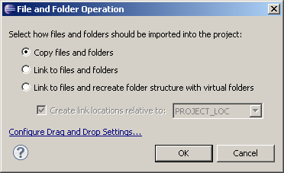
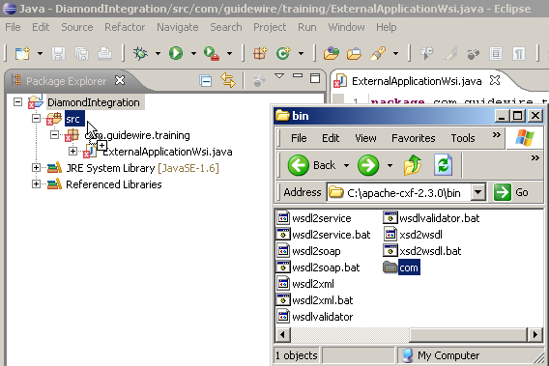
Step 3: Import code into your IDE
To copy files into Eclipse, simply drag the directory
onto the appropriate project
Notes:
The Java classes created from the WSDL must be available to the development environment in which the third-party application is configured.
In the example above, the com directory and all its Java classes created from the WSDL are made available to the Eclipse project that is being used to configure the third-party application.

Slide 25
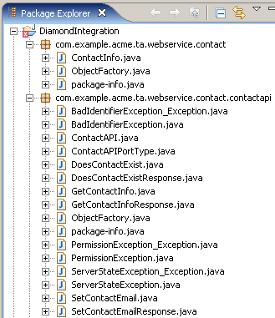
Web service and Gosu classes
Guidewire's generated WSDL contains:
  Class definitions for any types used as input parameters or return types
  Exceptions declared to be thrown by the web service methods
Gosu
Web Service
Notes:
The slide above simply shows the various classes generated by wsdl2java as seen in Eclipse. The slide also includes two classes in each package, ObjectFactory.java and package-info.java. These classes are Apache CXF artifacts that are not relevant to the example. The first class can be used to create instances of the class. The second provides annotation information. For more information, refer to the Apache CXF documentation.
Every WSDL for a Guidewire-published web service contains all the information needed to connect to the web service, make a request using one of the web service methods, and receive the response. This includes:
Classes that defines any "@WsiExportable" customer type the web service might return.In the screenshot above, ContactInfo.java is an example of this.
A class that defines the web service itself (the "@WsiWebService" class). In the screenshot above, ContactAPI.java is an example of this.
Classes for any exception that the web service might throw. In the screenshot above, BadIdentifierException_Exception.java, BadIdentifierException, PermissionException_Exception.java, PermissionException.java, ServerStateException_Exception.java, and ServerStateException.java are examples of this.
Classes for the connection information. In the screenshot above, ContactApiPortType.java is an example of this.
Classes for the methods and method responses. In the screenshot above, DoesContactExist.java, DoesContactExistResponse.java, GetContactInfo.java, GetContactInfoResponse.java, SetContactEmail.java, and SetContactEmailResponse.java are examples of this.

Slide 26
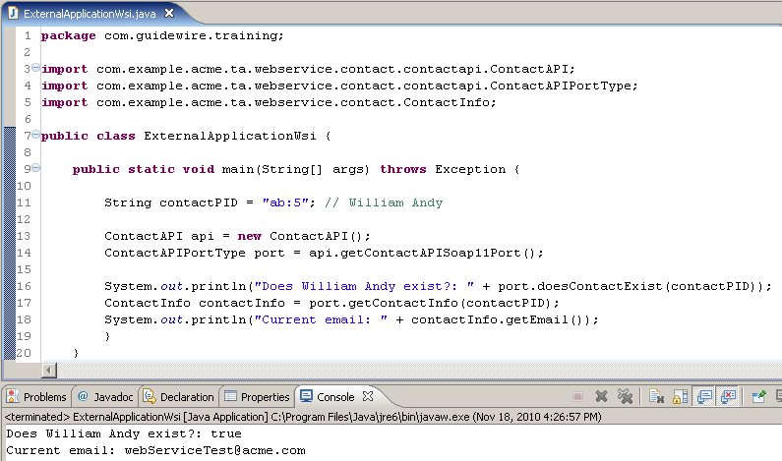
Step 4: Writing client code
Read slide notes for code details
Notes:
Once the Java classes are available to the IDE, any code in the IDE can make use of the classes. In the example above:
Lines 3-5: imports the WSDLtoJava generated Java classes.
Line 9: a Java main() method is used to emulate the third-party application.
Line 13: creates a new instance of the ContactAPI web service called "api". Note that this instance is based on the ContactAPI class, which is one of the Java classes created from the WSDL.
Line 14: creates a new instance of ContactAPIPortType called "port". Note that this instance is based on the ContactAPIPortType class, which is one of the Java classes created from the WSDL. Its value is set using a method from the ContactAPI instance.
Line 16: a call is made to the web service ("port.doesContactExist(contactPID)"). This call passes a string ("ab:5") to the Guidewire web service and gets a boolean response (true). The rest of line 16 then prints "Does William Andy exist?: " and the boolean value. You can see this print statement in the Console window at the bottom of the screenshot.
Line 17: creates a new instance of ContactInfo. It is called "contactInfo". Note that this instance is based on the ContactInfo class, which is one of the Java classes created from the WSDL. It is set using the getContactInfo() method of the web service and passes in "ab:5" as an input parameter. In other words, the third-party application requests a ContactInfo instance for the contact with public ID "ab:5" and stored this instance in the local contactInfo object.
Line18: prints the value of the contactInfo object's email. This is done by retrieving the value of the Email field using getEmail() and then printing it to the console. You can see the results of the print statement in the Console window at the bottom of the screenshot.

Slide 27
Redeploying the web service client code
If you create a client from the WSDL and then:
  Remove or add a
  method to the web service
  Change the signature
  of a method
  including parameters
  Change the nature
  of a Gosu class
  returned by a method
  Change only the internal behavior of one or more methods
Regenerate the
web service client!
Do NOT regenerate the web service client
Notes:
Remember that the WSDL only provides the XML grammar for describing how a consumer of a web service can interact with a web service.

Slide 28
  Publish a Guidewire web service
  Return instances of a Gosu class from a web service
  Test web services locally
  Describe how external systems connect to a Guidewire web service

Slide 29
What must be added to a Gosu class in order to make it:
  A Guidewire web service?
  A valid return type for Guidewire web service methods?
Identify if the following are true or false about a Guidewire WS-I web service API:
  It can return a simple value, such as a boolean or string.
  It can return an instance of any Gosu class.
  It can return an instance of any Guidewire data model entity.
  The WSDL gets generated when you save the class.
  It can list a set of permissions required to use the API.
  It can modify Guidewire data.
Notes:
Answers
1. a) The @WsiWebService annotation is the only thing required to make a Gosu class a Guidewire web service.
b) The @WsiExportable annotation and the keyword "final".
2. a) True.
b) False. (It can return only instances of Gosu classes that are final and have the @WsiExportable annotation.)
c) False. (Instances of Guidewire data model entities cannot be returned from WS-I web service methods.)
d) False. (The WSDL is generated when an external system requests it.)
e) True.
f) True.

